Slide 1
building an intelligent signal sense making system
Your team name
Submission guideline
Provide your team name in slide 1.
Provide your team members’ names in slide 2
Provide your answers in slide 5.
Rename your pptx file as your team name and upload into LumiNUS.

Slide 2
Team members
List your team members’ full name (as in your course registration)

Slide 3
Guideline
Choose any one of the following two problem statements provided in the next slide.
Statement 1: An intelligent access control system
Statement 2: A classroom attendance system
Apply any one sense making pipeline (you might want to skip certain module for your specific solution) to design your system for your chosen problem statement

Slide 4
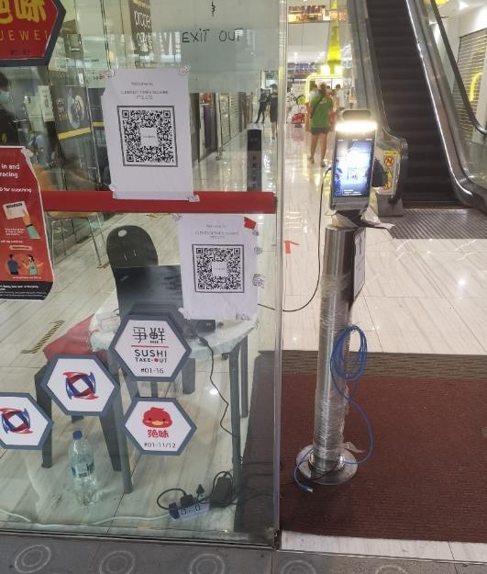
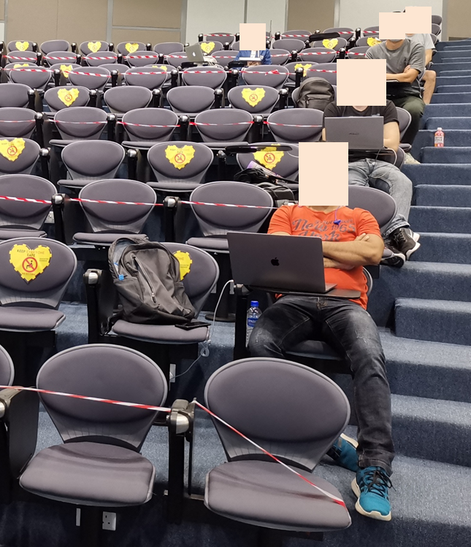
Problem statements
Statement 1: Access control | Statement 2: Classroom attendance
Ensure all visitors measure their temperature. Ensure all visitors scan their TraceTogether APP. Count the number of visitors. Decline the entrance if the number of visitors exceed certain capacity. | Mark student attendance by facial recognition. Ensure all students wear facial masks. Mask students’ face for privacy concern. Provide attendance statistics to lecturers.

Slide 5
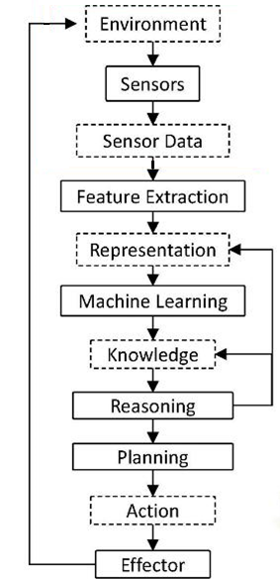
Intelligent sensing system pipeline
Pipeline 1
Apply any one pipeline (you might want to skip certain module for your specific solution) to design your system for your chosen problem statement.
Feel free to insert more slides for your answers.
Pipeline 2

